Slide 1
INTELLIGENT DOCUMENT PROCESSING SYSTEM

Slide 2
Problem Statement and Solutions
Organizations handle thousands of documents daily, such as:
Invoices
Resumes
ID Cards
Reports
Solution
Develop an Intelligent Document Processing System that automatically extracts structured information from unstructured documents using OCR and NLP techniques.

Slide 3
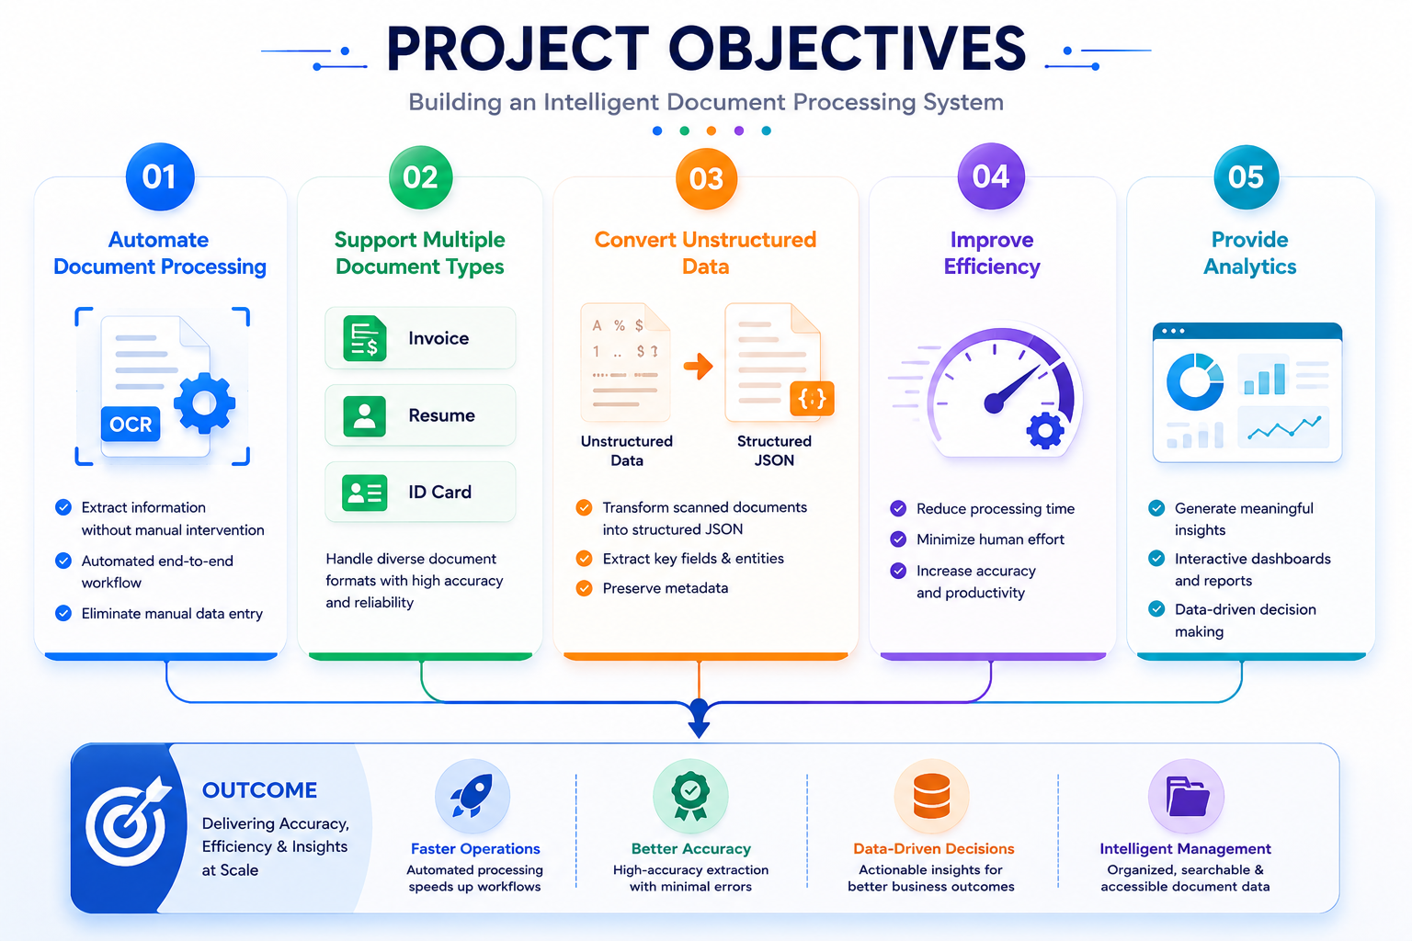

Slide 4
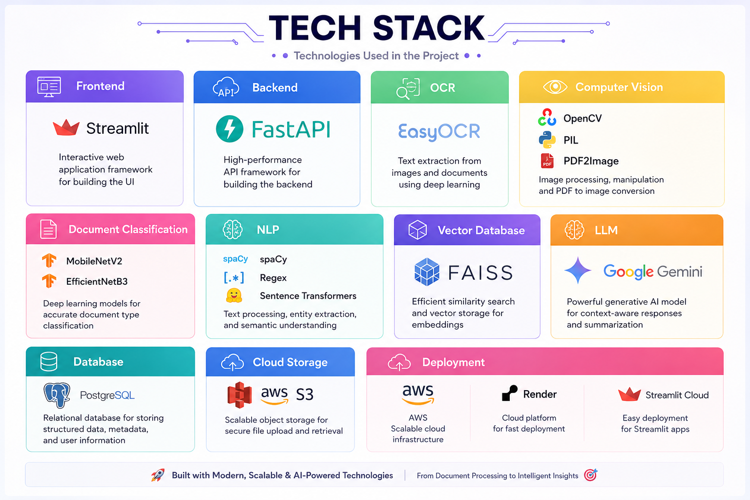

Slide 5
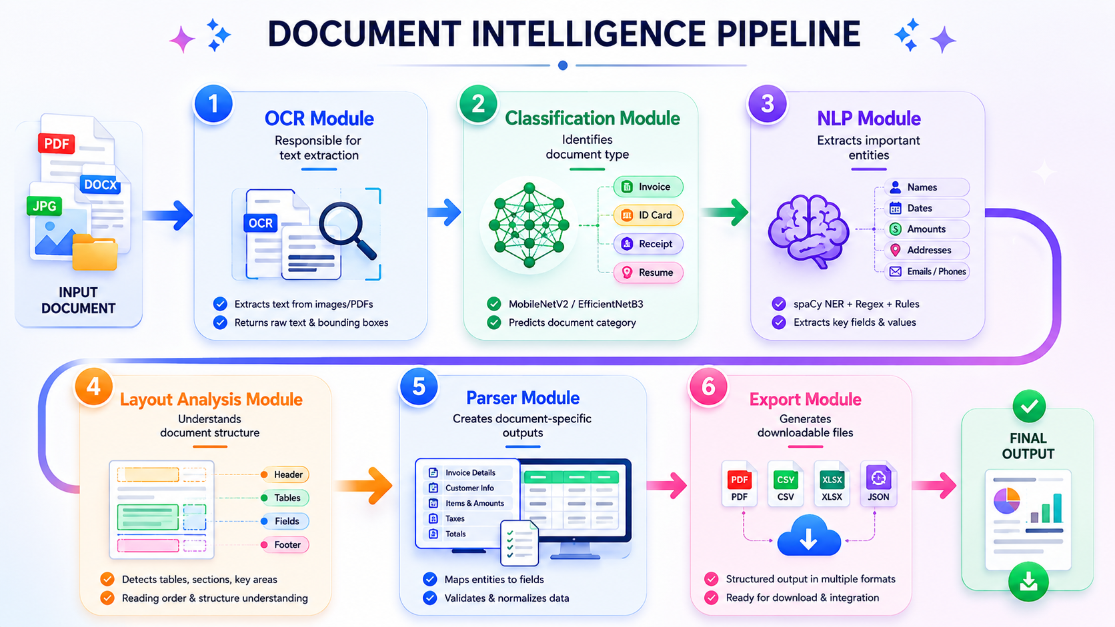
Project Modules

Slide 6
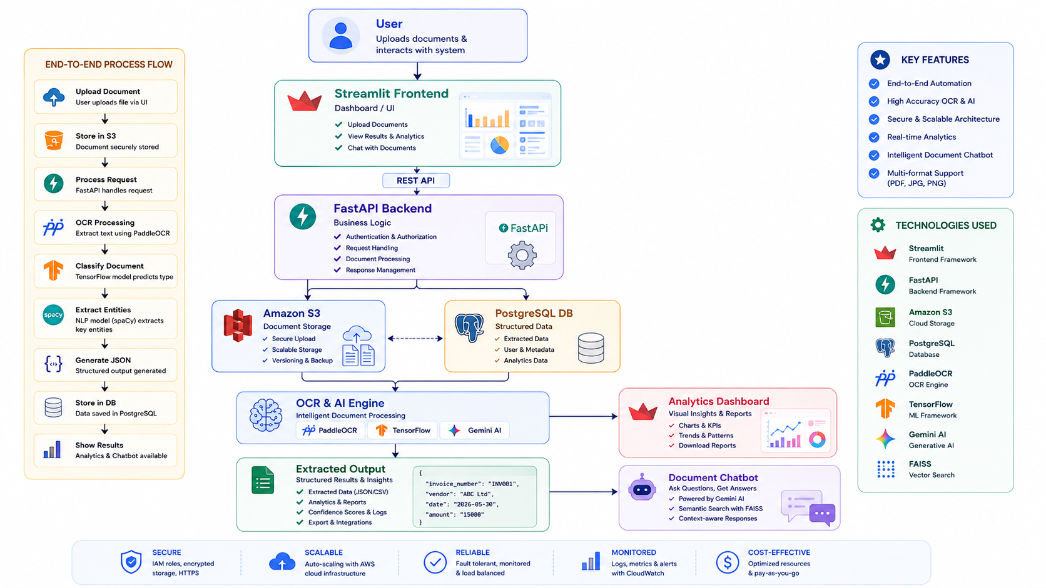

Slide 7
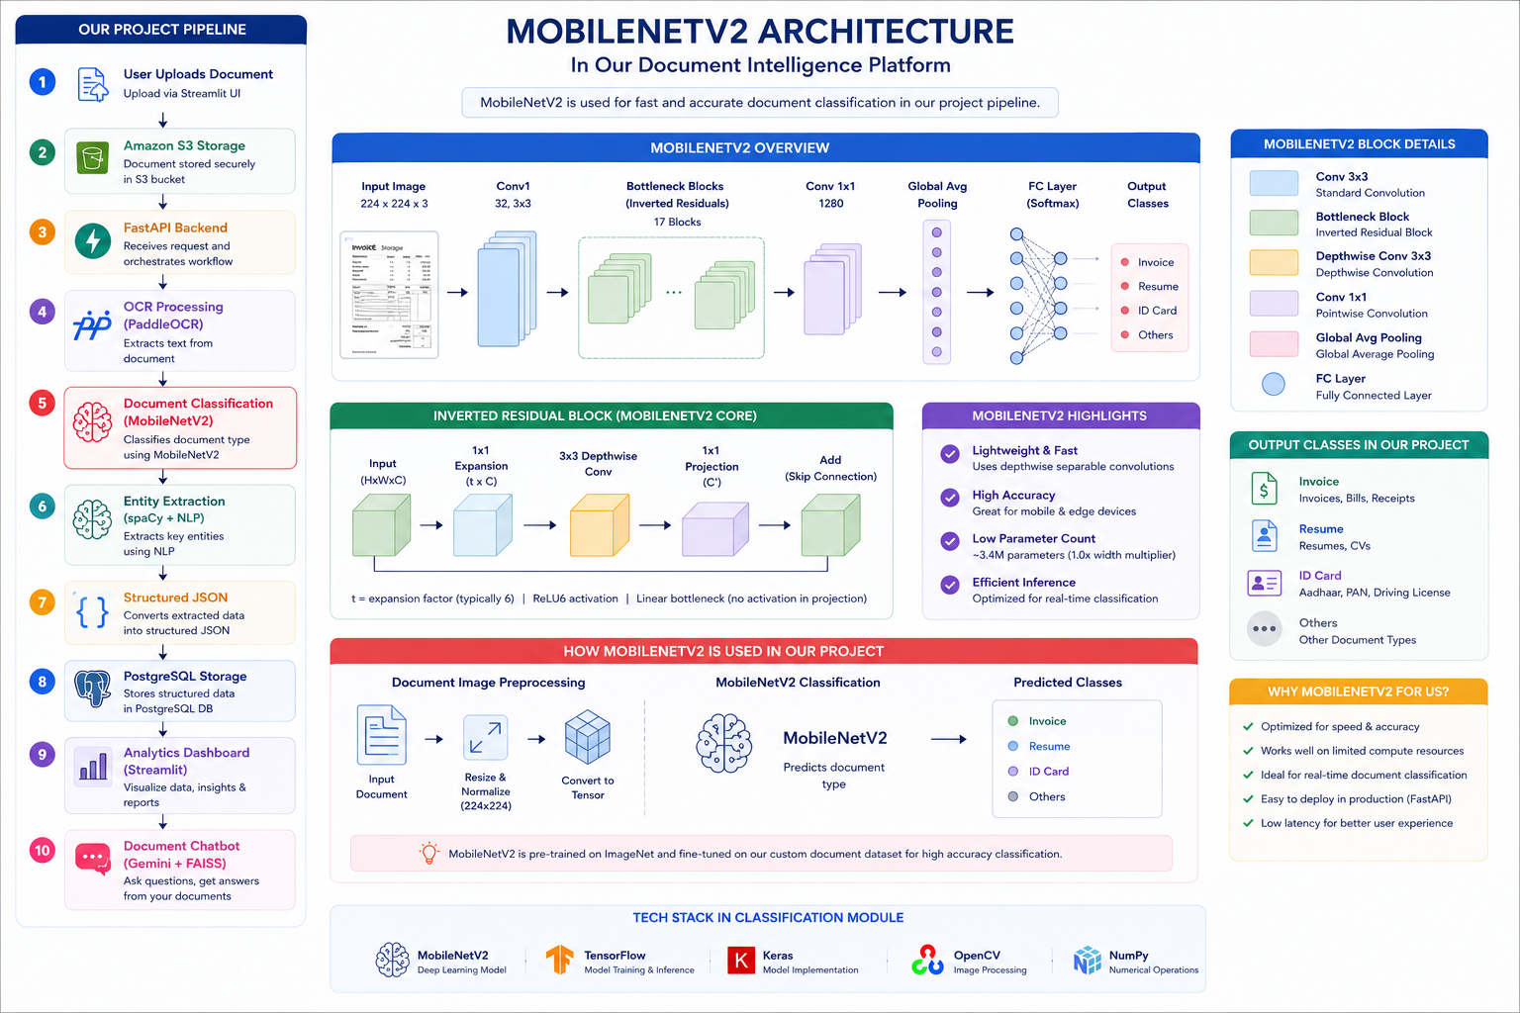

Slide 8
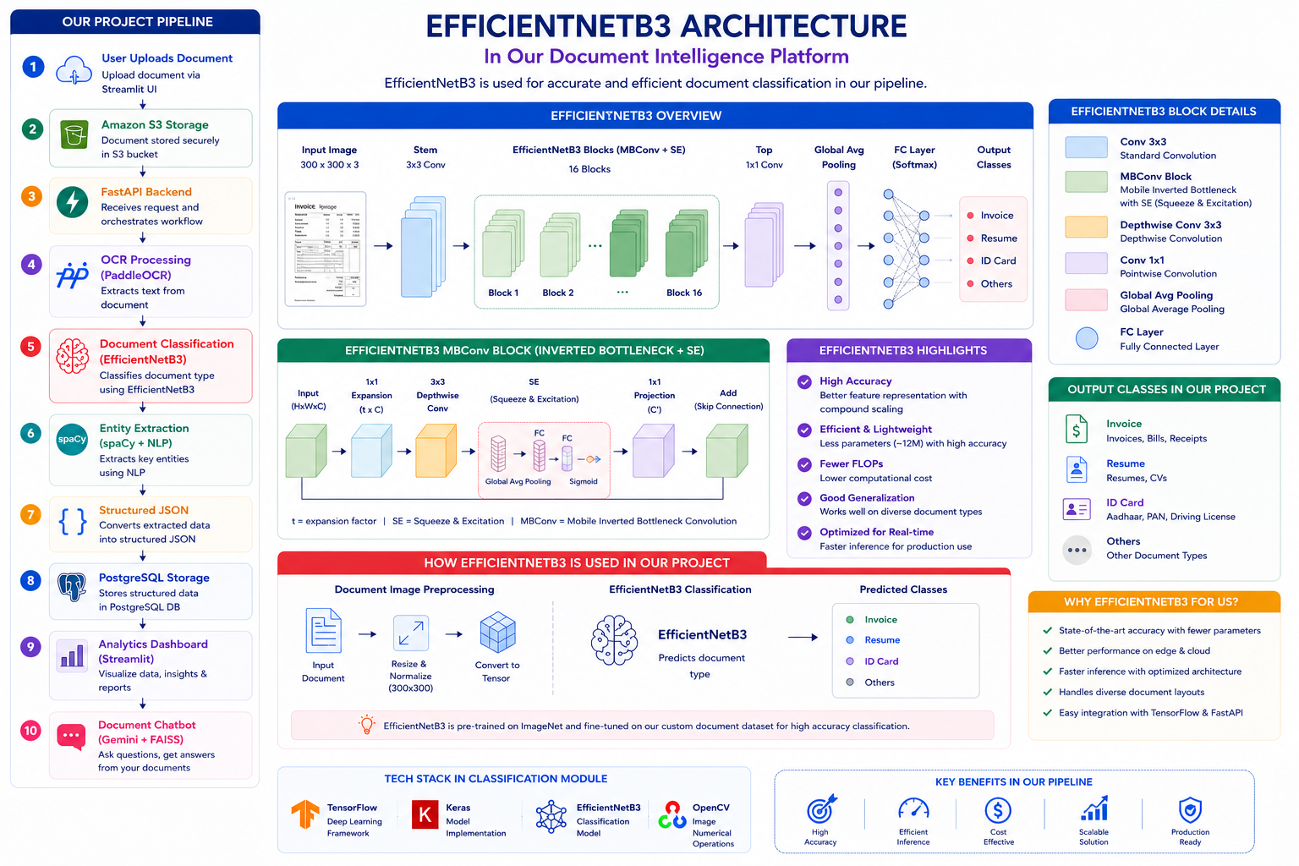

Slide 9
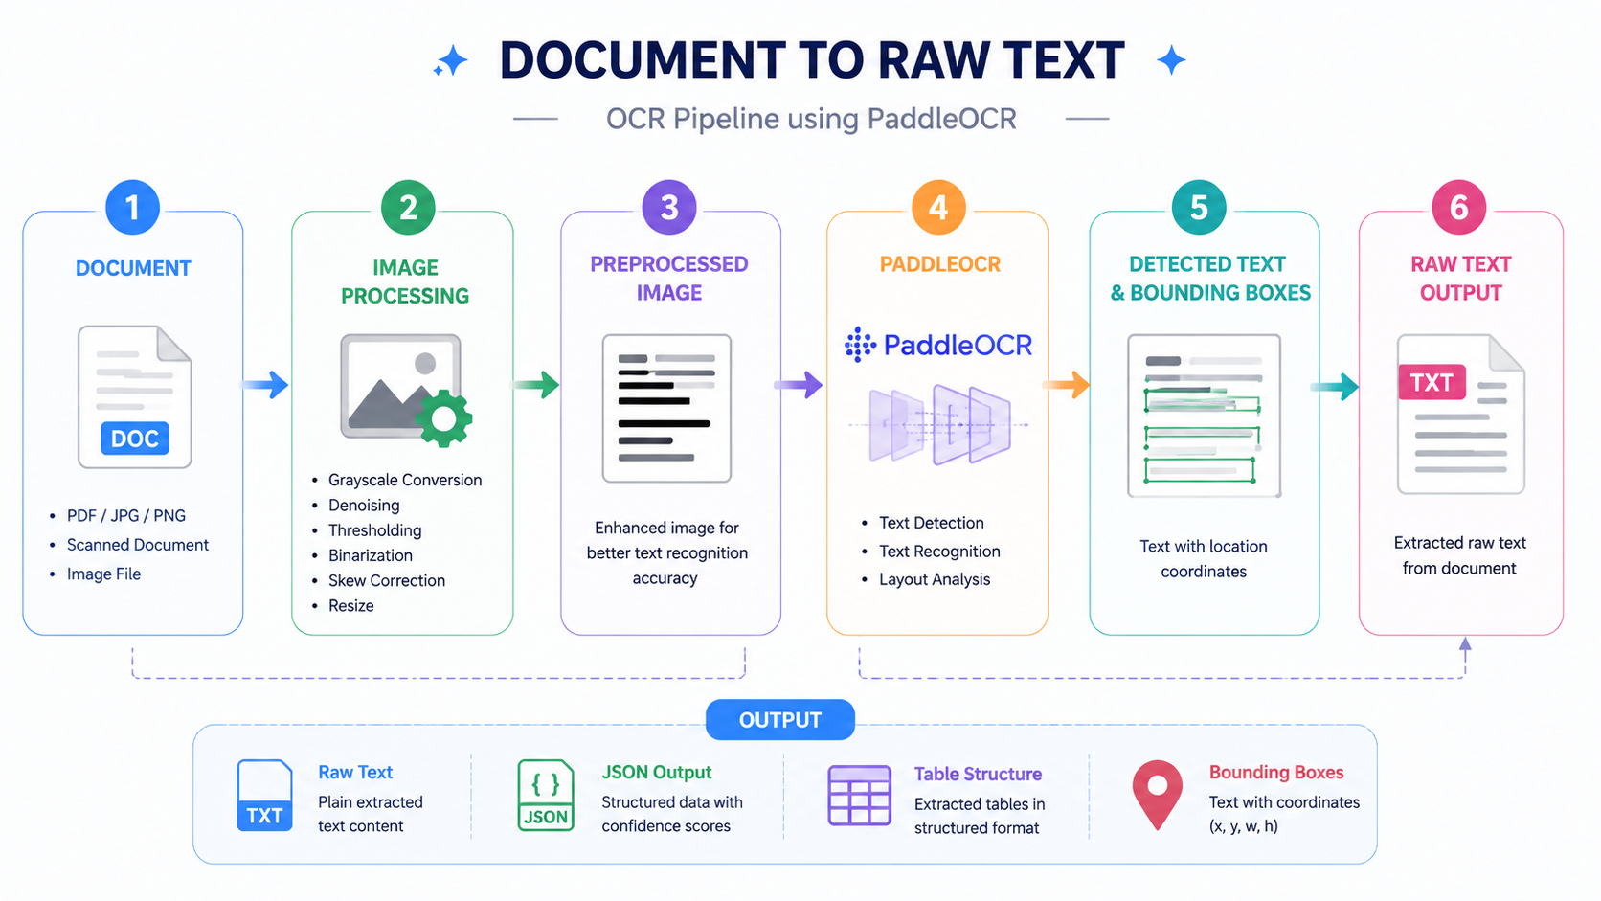
OCR Processing (Paddle OCR)

Slide 10
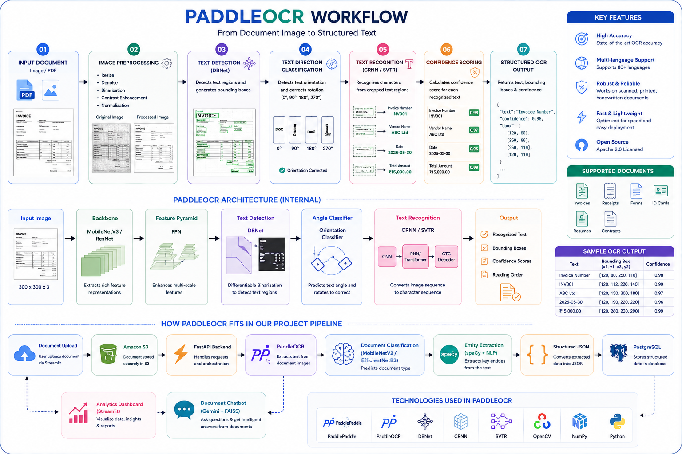

Slide 11
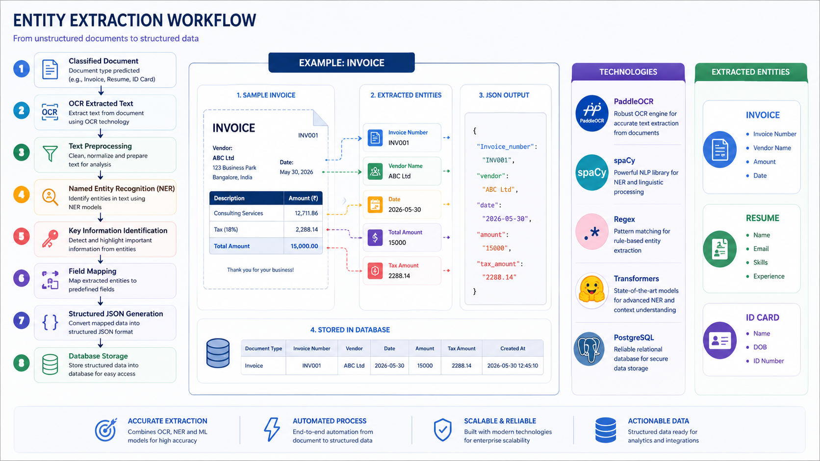

Slide 12
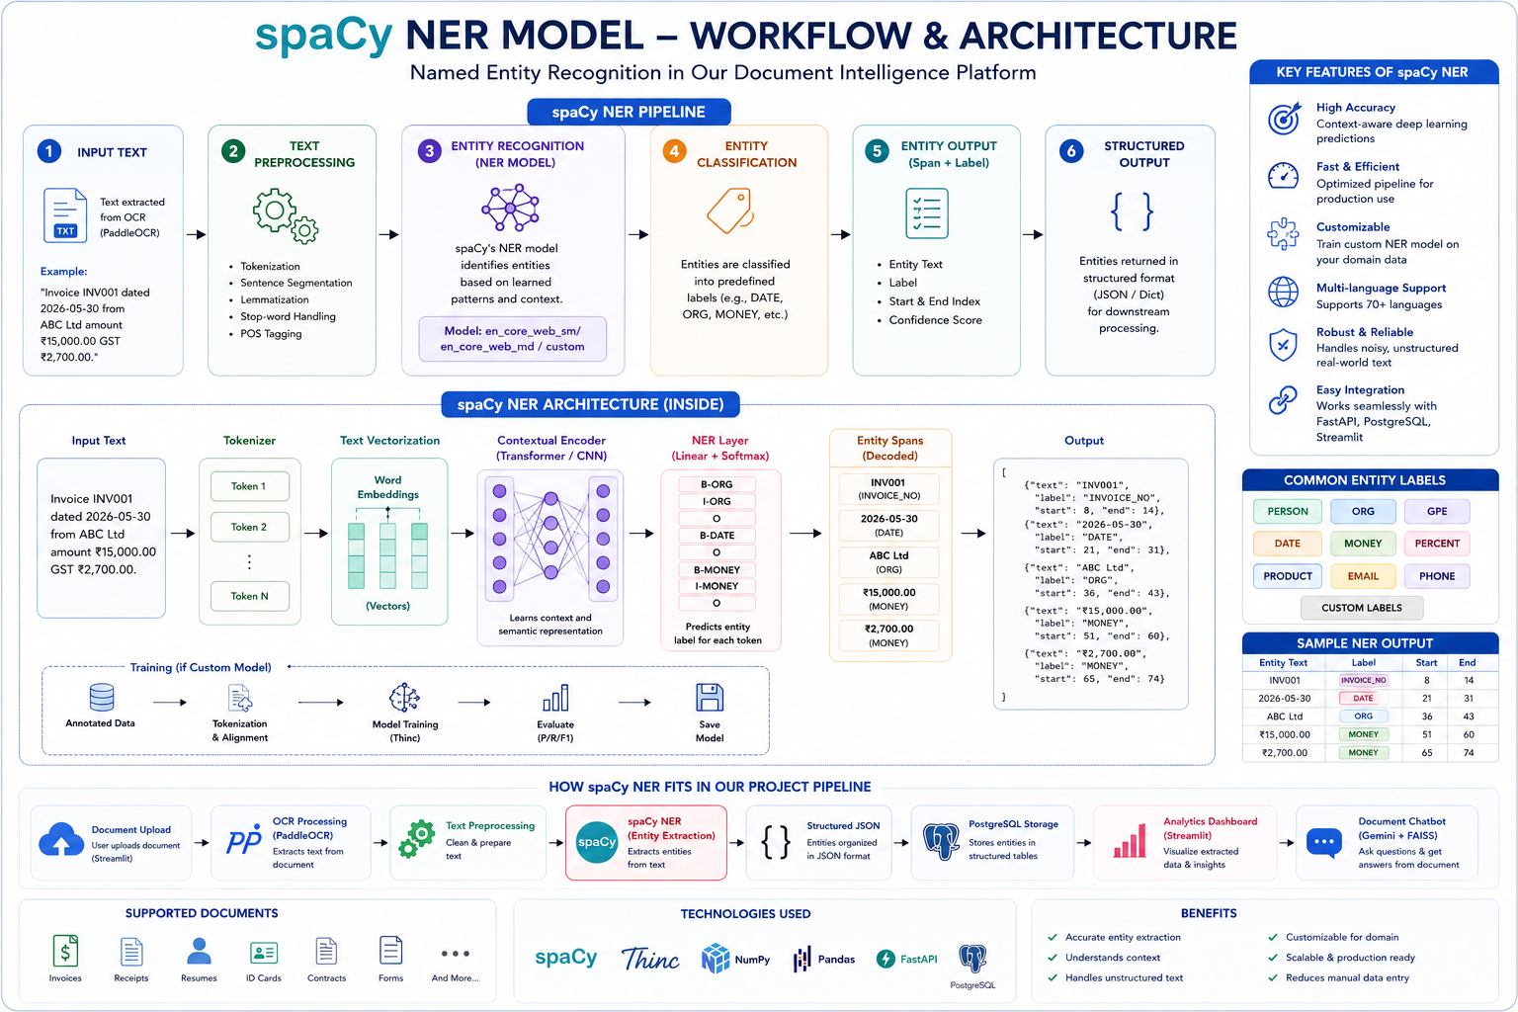

Slide 13
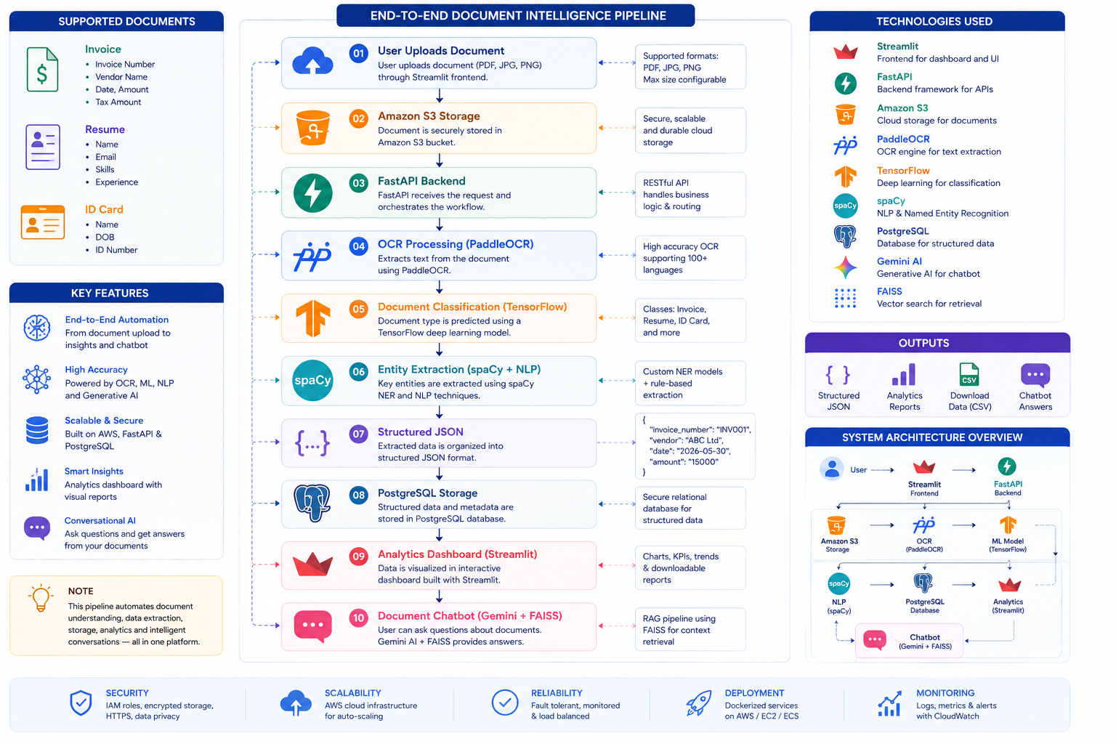

Slide 14
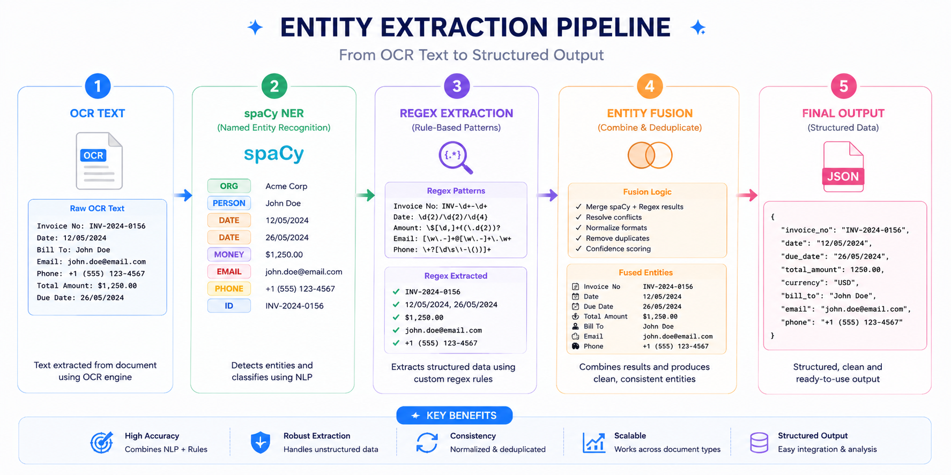
NLP Processing& Entity Extraction

Slide 15
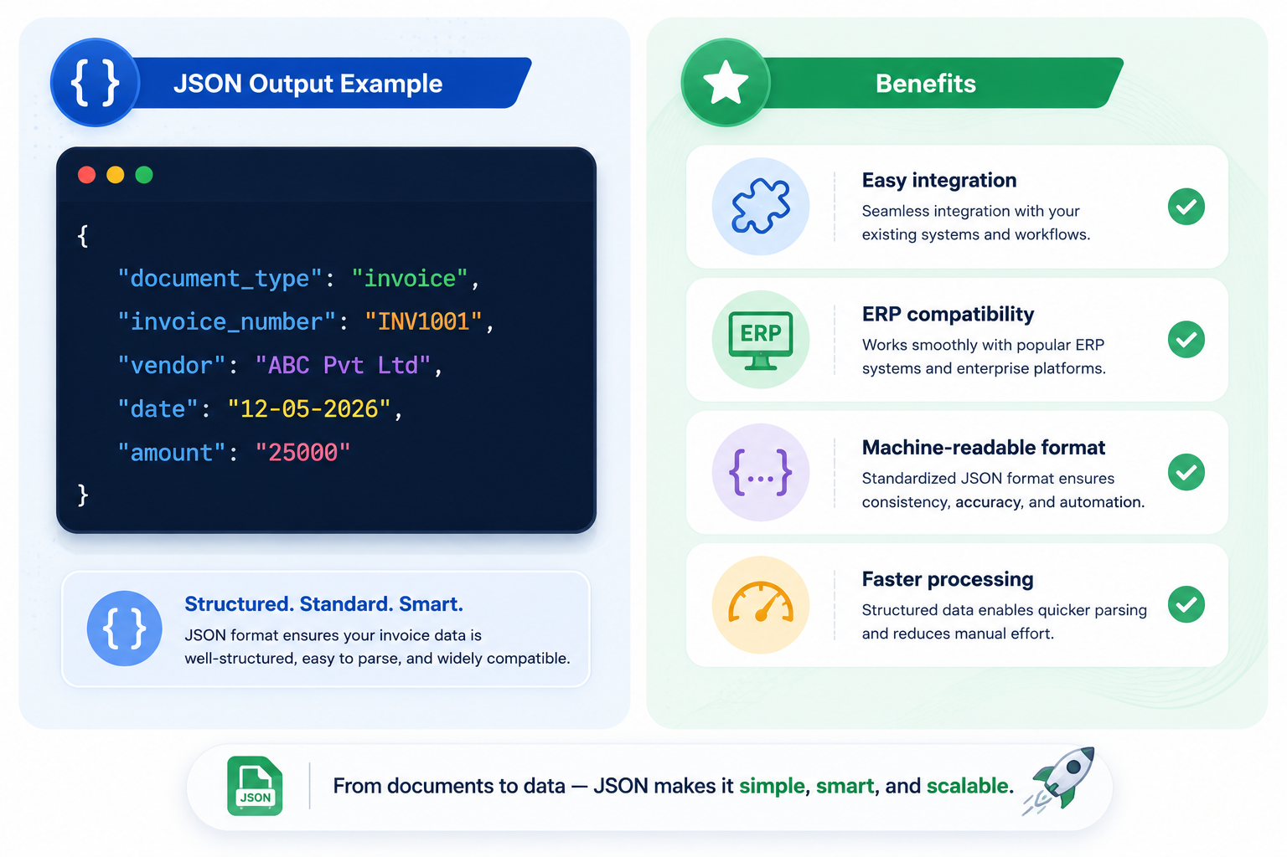
Structured Output

Slide 16
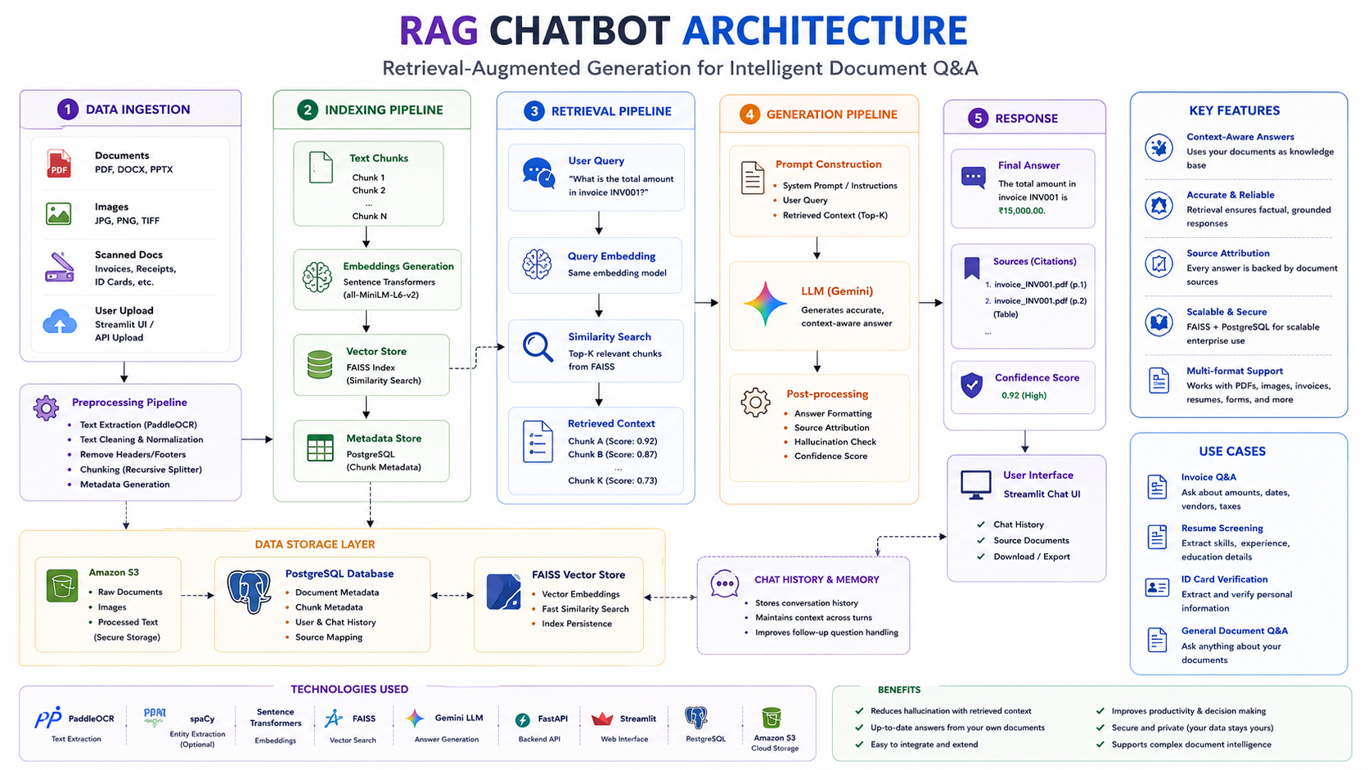
RAG-Based CHATBOT Architecture

